Slide 1
Race Detection

Slide 2
Overview
Review of basic techniques
Review of state-of-the-art technique: predictive analysis
Find problems of predictive analysis

Slide 3
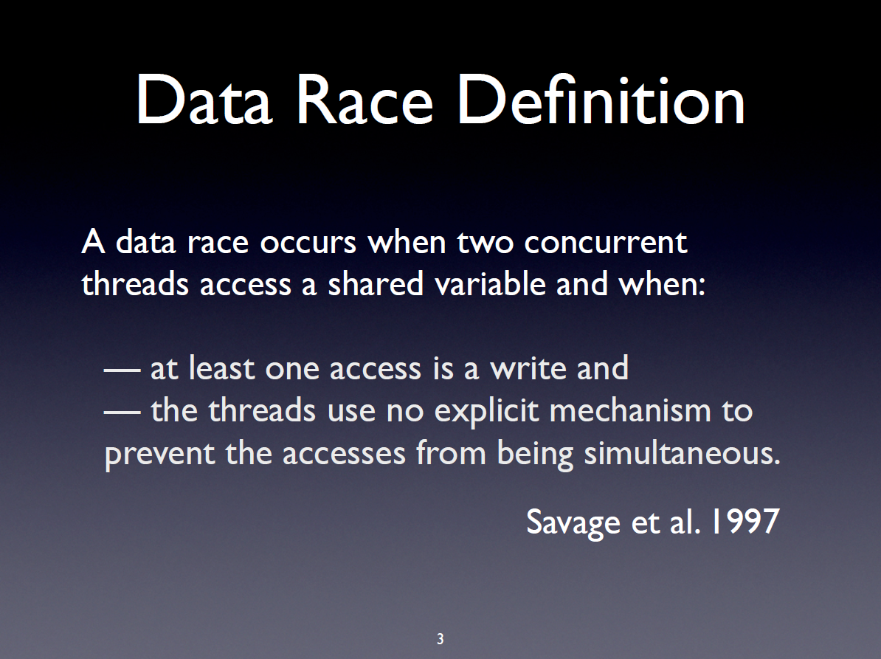

Slide 4
Existing work
Most race detection analyses are dynamic:
lockset
happens-before
Hybrid
Universal causal graph
predictive analysis

Slide 5
1 Lockset
Race ⬄ not protected by same locks.
T1 T2
x=5;
fork T2;
print x;
join T2;
Report race!
false positive
Miss the important order imposed by fork.

Slide 6
2 Happens-before
Race ⬄ not ordered by Happens-before (HB).
HB between fork/join, wait/signal, rel(l)/acq(l).
T1 T2
x=5;
acq(l)
y=3;
rel(l);
acq(l);
z=4;
rel(l);
print x;
HB between lock regions
Must respect
Report no race for accesses(x)
Real data race!
Impose unnecessary order between lock regions.

Slide 7
3 Hybrid
Race ⬄ (1) not ordered by the hard HB (2) not protected by same locks.
Hard HB: fork/join, wait/notify. Must respect it.
T1 T2
acq(l);
fork T2;
x=5;
y=3;
rel(l);
acq(l);
z=4;
rel(l);
print x;
Hard HB.
no common locks
Report a race.
false positive!
Hard HB enforces new HB, which orders the accesses(x). Miss new HB.
How does new HB come?

Slide 8
4 Universal causal graph
Race ⬄ not ordered by the hard HB or the derived hard HB.
T1 T2
acq(l);
fork T2;
x=5;
y=3;
rel(l);
acq(l);
z=4;
rel(l);
print x;
can find the new HB
Wont report false positive in this case

Slide 9
4 Universal causal graph
Race ⬄ not ordered by the hard HB or the derived orders.
x=5;
acq(l);
y=3;
rel(l);
acq(l);
if(y==3)
print x;
rel(l);
still false positive
No hard HB, report race
Not a real one
suppose we enforce…
x=y=0, initially

Slide 10
5 Predictive analysis
Soundness: all reported races are real.
Given a trace R, statically predicts a new trace R’ by reordering events.
T1 T2
x=5;
acq(l);
y=3;
rel(l);
acq(l);
if(y==3)
print x;
rel(l);
x=y=0, initially
The key is the feasibility of R’

Slide 11
5 predictive analysis
Yannis Smaragdakis POPL’12
Jeff Huang PLDI ’14
Chao Wang FM ’09

Slide 12
Yannis approach
Race ⬄ (1) not ordered by the hard HB (2) not ordered by inter-thread dependence edge, (3) not ordered by derived orders.
x=5;
acq(l);
y=3;
rel(l);
acq(l);
if(y==3)
print x;
rel(l);
dependence on y
respect it.
no dependence
reorder for race
T1 T2
x=5;
acq(l)
y=3;
rel(l);
acq(l);
z=4;
rel(l);
print x;

Slide 13
Yannis approach
Reordering the inter-thread dependence ALWAYS leads to infeasible executions.
x=5;
acq(l);
y=3;
rel(l);
acq(l);
print x;
if(y==3)
dosth();
rel(l);
conservative
inter-thread dep => lock region order
report no race.
real race!
reordering the dep on y does not affect “print x” (always executed!)
x=y=0, initially

Slide 14
Jeff approach
Race ⬄ (1) not ordered by the hard HB (2) not ordered by feasibility-affecting inter-thread dependence edge, (3) not ordered by derived orders.
Feasibility-affecting dependence for an event: the dependences up to the preceding branch event.
for “print x”:
no preceding
no deps to respect
x=5;
acq(l);
y=3;
rel(l);
acq(l);
if(y==3)
print x;
rel(l);
x=5;
acq(l);
y=3;
rel(l);
acq(l);
print x;
if(y==3)
dosth();
rel(l);
for “print x”;
preceding: if(y==3)
dep before it
respect them.

Slide 15
Jeff approach
Feasibility-affecting dependence for an event: all dependences before the preceding branch.
Strong Assumptions/Limitations:
(1) the event always control depends on the preceding branch.
In trace, preceding branch != guarding branch.
if(y==3) if(y==3) {}
{ print x; } print x;
(2) the branch reads all variables involved in the inter-thread dependences, and the branch value always changes if any dependence is not preserved.
y=1;
x=0;
y=3;
if(y>-100)
print x;
introduce irrelevant branch and deps.
respect => miss
reordering does not necessarily change branch value

Slide 16
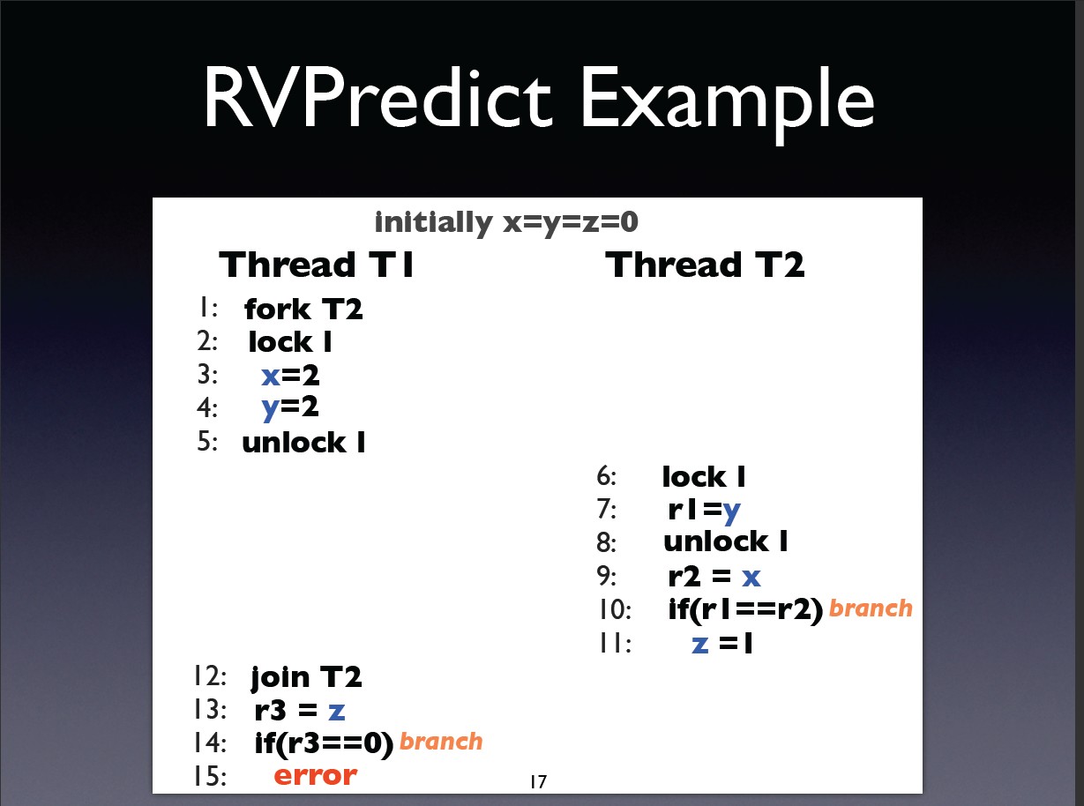
Race: 3 and 9 ?
Race: 11 and 13 ?

Slide 17
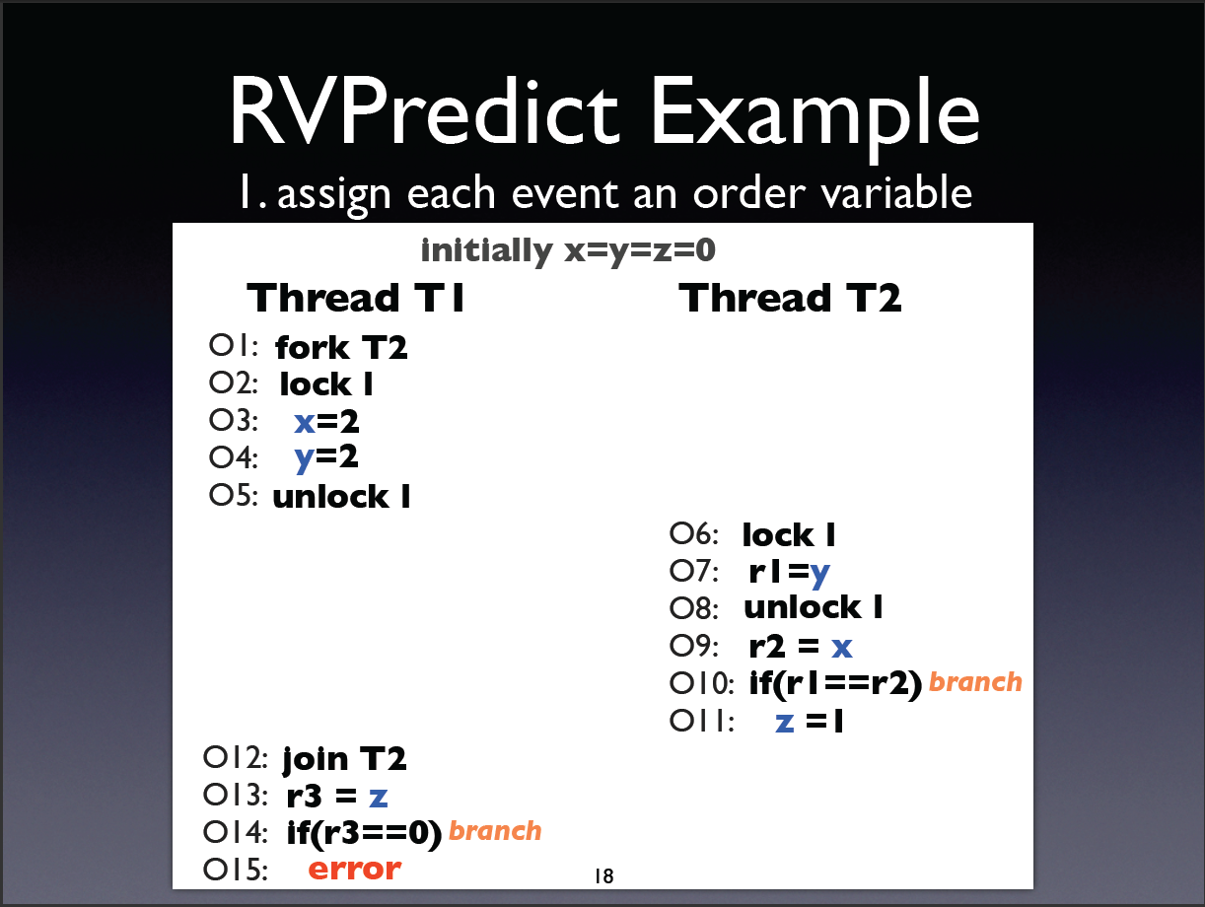

Slide 18
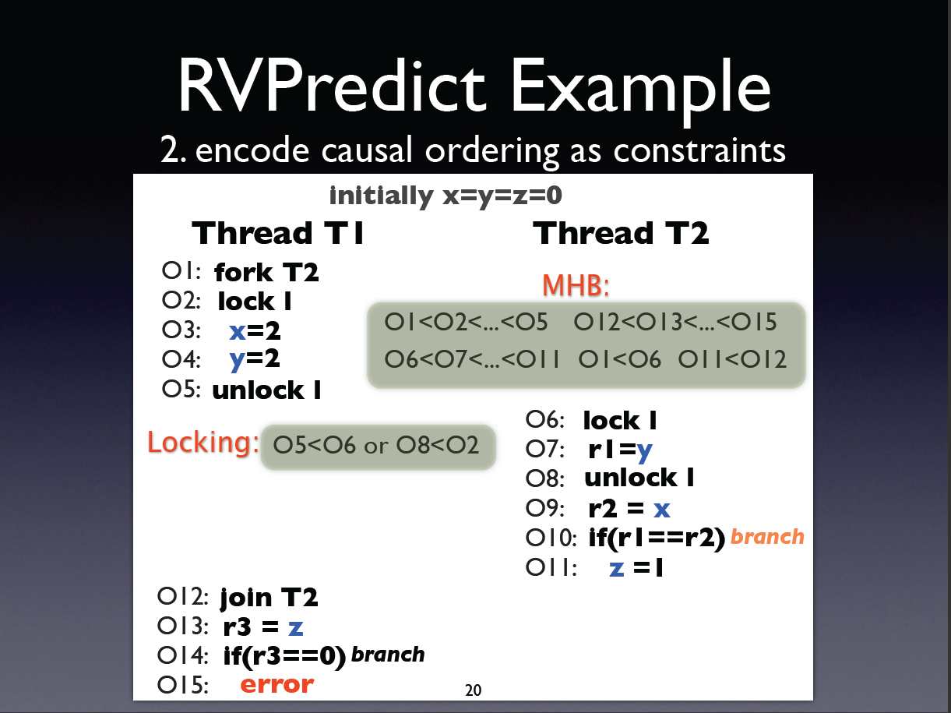

Slide 19
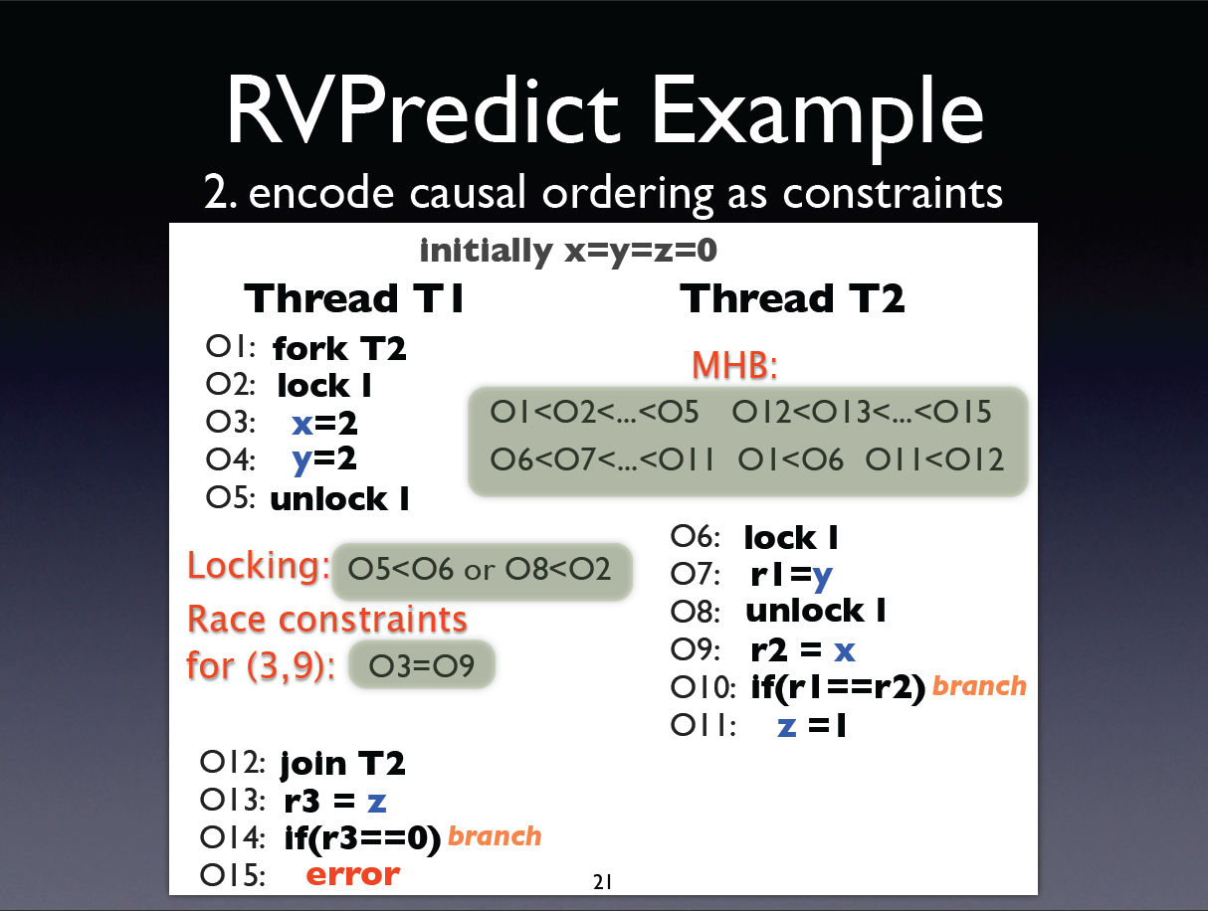

Slide 20
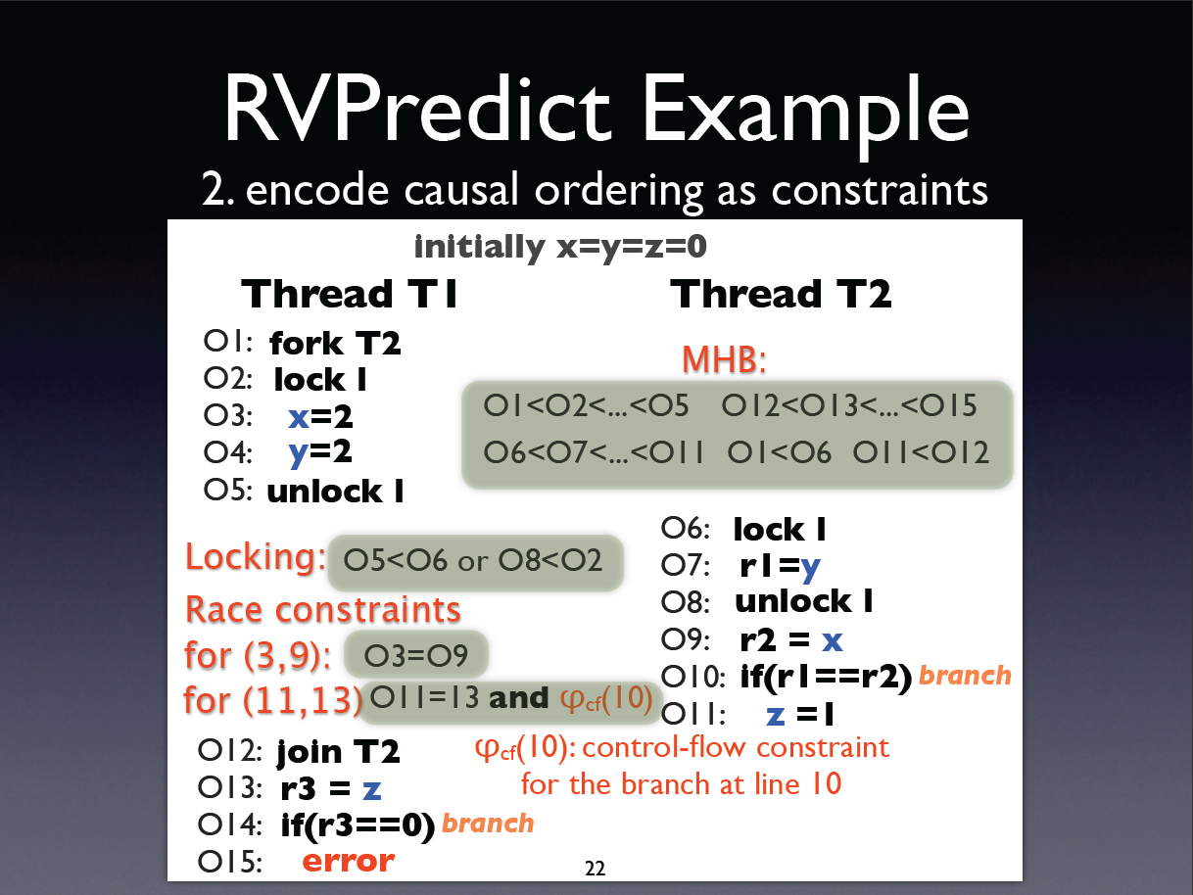

Slide 21
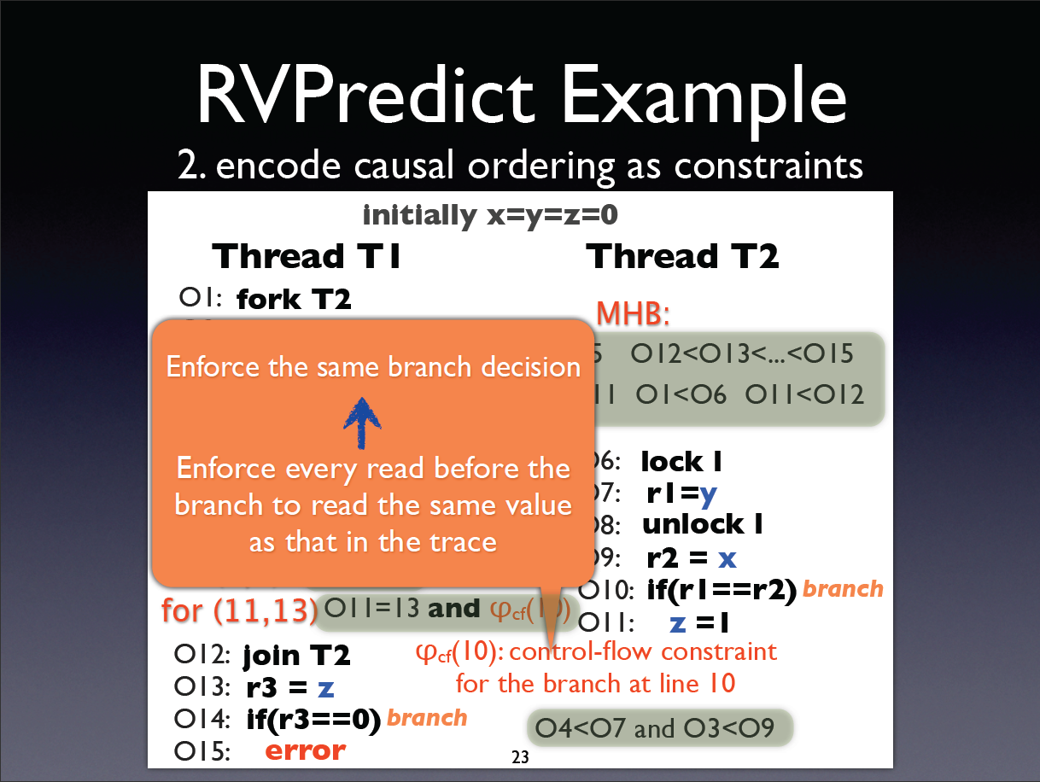

Slide 22
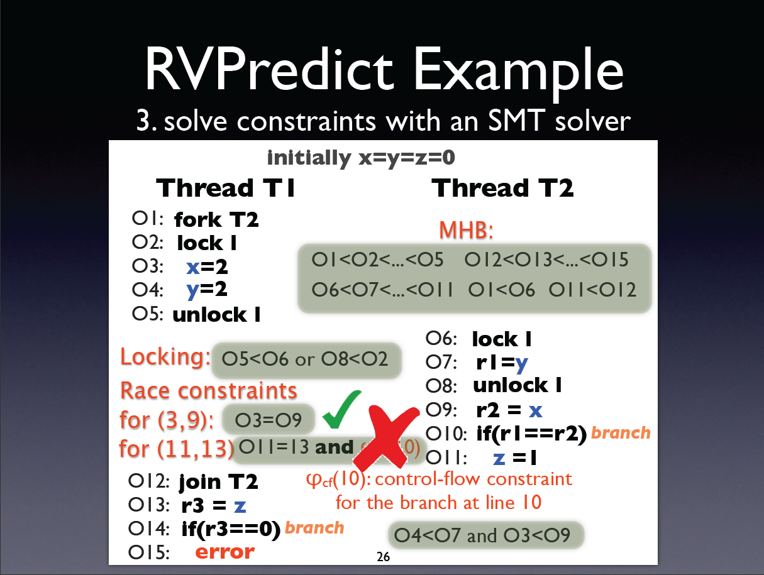

Slide 23
Essentially, if there is a preceding branch, we need to preserve all inter-thread dependences up to it.
Worst case, suppose we add the trivial condition, if(!(x==0&&x==1)), before each shared access event, then, Jeff work = Yannis work

Slide 24
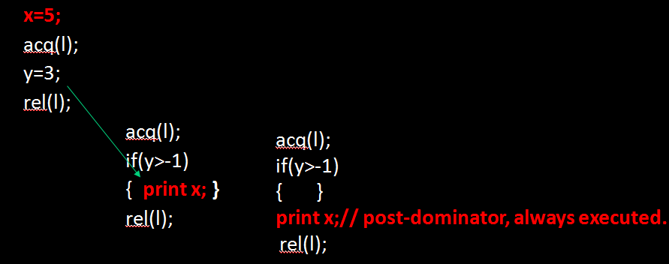
Jeff approach
Feasibility-affecting dependence for an event: all inter-thread dependences up to the first branch preceding the event.
Strong Assumptions: (1) the event always control depends on the preceding branch. (2) the branch reads from all variables in all inter-thread dependences, the branch value changes if any dependence is not preserved.
valid for left example.
move “print x” out. Invalid.
following assumption-> unnecessary constraints, miss races
Cause: oblivious of control structure.
==3)

Slide 25
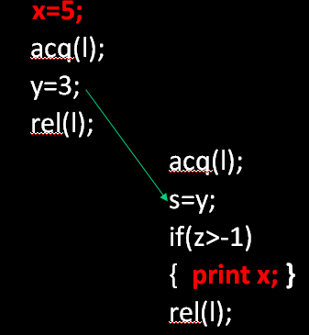
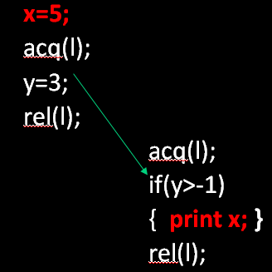
Jeff approach
Feasibility-affecting dependence for an event: all inter-thread dependences up to the first branch preceding the event.
Strong Assumptions: (1) the event always control depends on the preceding branch. (2) the branch reads all variables involved in the inter-thread dependences, and the branch value always changes if any dependence is not preserved.
following assumption-> unnecessary constraints, miss races
Cause: cannot analyze the change of control flow value.

Slide 26
General observation
Feasibility-affecting inter-thread dependence for an event.
(1) the event control depends on a branch
(2) the order of inter-thread dependences affects the branch value.
x=5;
acq(l);
y=3;
rel(l);
acq(l);
if(y>-1)
print x;
rel(l);
control flow structure by introducing branch exit.
branch start; event; branch exit;
control flow value.
encode the feasibility of branch conditions as constraints.
reason about them with a solver
control dep
x=y=0, initially

Slide 27
Lastly, even if the branch is infeasible after reordering, we can still predict races for the other branch, the un-explored branch.
The unexplored branch should be simple enough for static prediction. No heap update, no undecidable values.
x=5;
acq(l);
y=3;
rel(l);
acq(l);
if(y==3)
{ print x; }
else
{ print x; }
rel(l);
NEW:
branch exploration capability

Slide 28
Solution
Control flow structure:
find the relevant branches by adding branch exit.
Control flow Value:
Feasible? Record old values and encode the feasibility constraints for path conditions
Infeasible? Limited prediction of unexplored control flow branch => More Control Flows.

